Slide 1
L2W13: Project 2
2023. 5. 29. Mon.
AISys, SNU

Slide 2
Contents
Project: Fighter-controlled Game
Formats
Compile & Output / Input
Skeleton Code
Mac / Windows
Todo
Unit / Interaction / Overall System
Extra Credits
Deadline

Slide 3
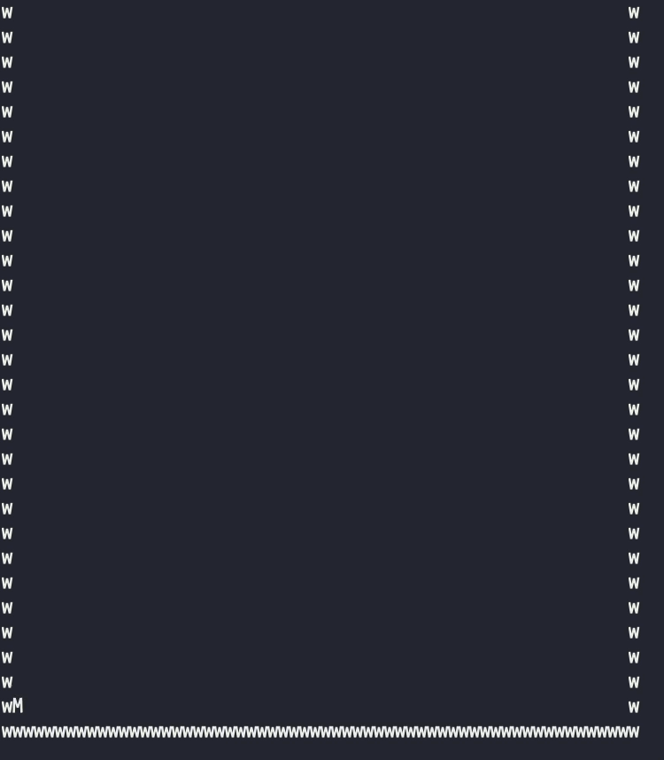
Project 2 : Fighter-controlled Game
In Project 2, you will make a fighter-controlled game.
What you need to implement!
10 existing classes
My_plane(M), Bullet(‘, ^, !)
Powerup_bullet(P), Levelup_bullet(L)
Enemy_1n(n), Enemy_2r(r), Enemy_3s(s)
Enemy_4d(d), Enemy_5a(a), Enemy_bullet(*)
Interaction between class objects. (See p.25)
Compute the total score.
If you destroy enemies, you get some score.
Pause when the key ‘p’ is pressed.
Create events from the input file.

Slide 4
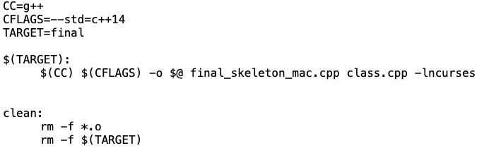
2. Formats: Compile & Output
What is a Makefile?
A file that defines a set of tasks to be executed.
‘make’ : Compile a program from source code.
‘make clean’ : Rid executables, object files, etc.
e.g. ‘g++ --std=c++14 –o final final_skeleton_mac.cpp class.cpp -lncurses’ equal to ‘make’.

Slide 5
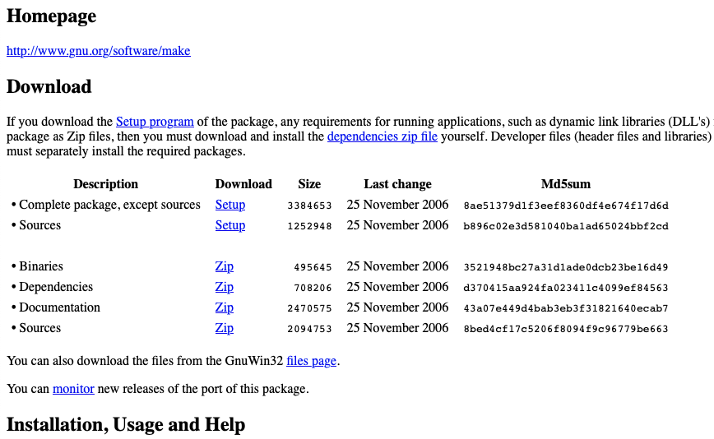
2. Formats: Compile & Output
If you use Windows, you need additional effort for ‘make’.
Download the setup program.
(https://gnuwin32.sourceforge.net/packages/make.htm)

Slide 6
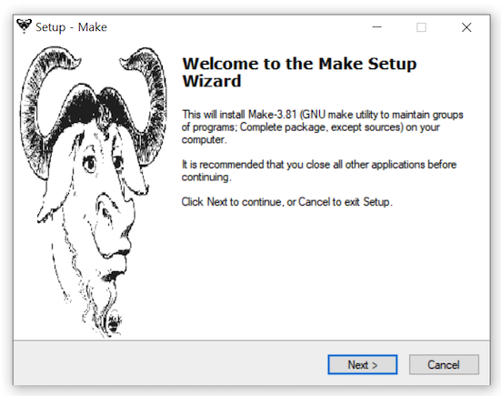
2. Formats: Compile & Output
2) Proceed with the installation. Just press the ‘Next’ button continuously.

Slide 7
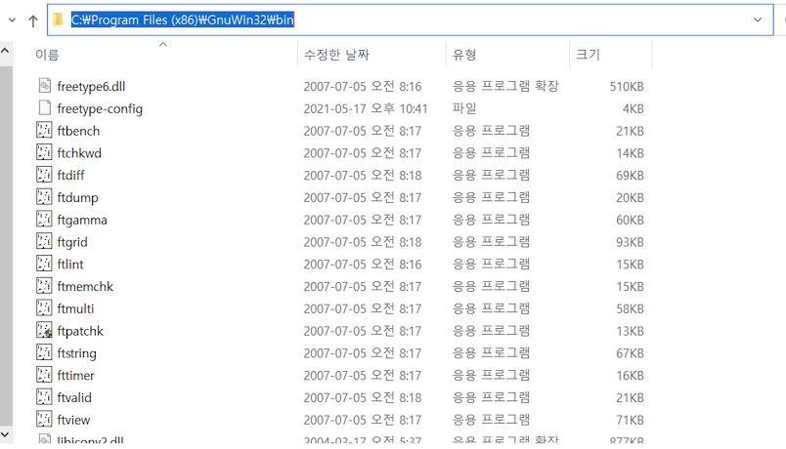
2. Formats: Compile & Output
3) After the installation is complete, please find the folder where GnuWin32 is installed. Copy the path of the ‘bin’ folder.

Slide 8
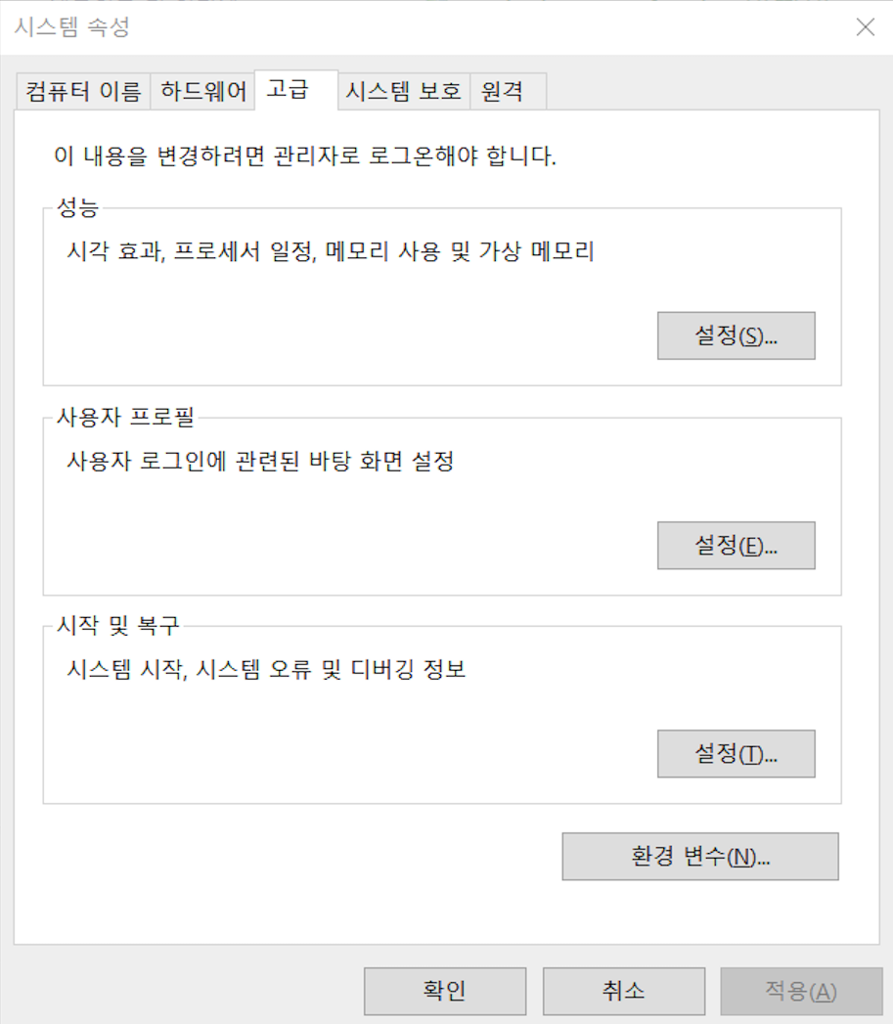
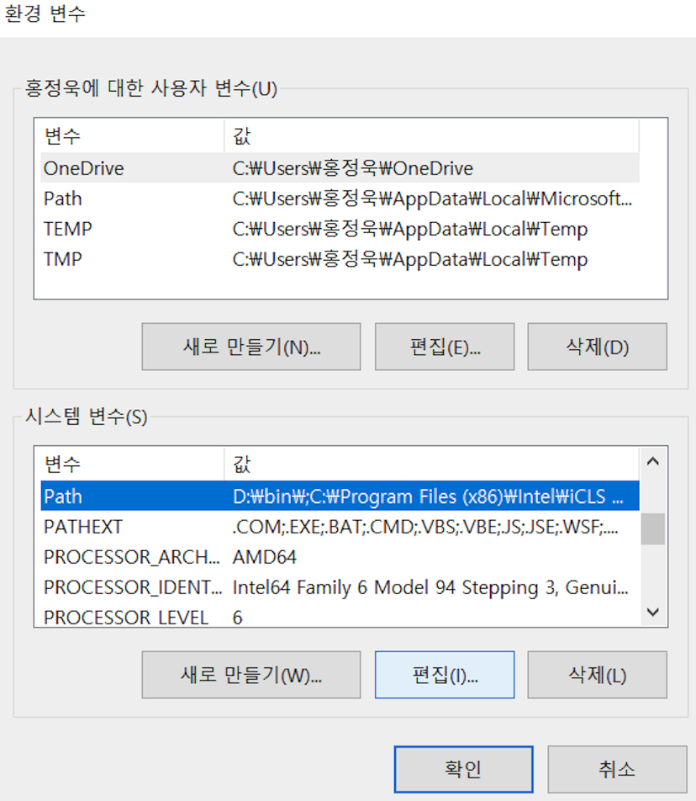
2. Formats: Compile & Output
4) You must register the location of the bin folder as an environment variable. Please add the location of the bin folder to the ‘Path’. Then, you can use ‘make’ in the Windows.
2
1
3
4

Slide 9
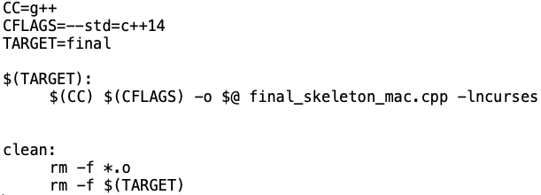
2. Formats: Compile & Output
In Project 2, you must use Makefile for compilation.
We already prepared Makefiles.
If you want to compile more files, you must add the files in ‘Makefile’.
Write the command ‘make’.
e.g.
Add your files here!

Slide 10
2. Formats: Compile & Output
You must follow the format below.
1. Compile (use Makefile)
make
(We will use this Makefile for grading.)
2. Run
mac : ./final input/1.txt
windows : final.exe input/1.txt
Caution1: The terminal size must be large enough for proper output!
Caution2: Use ‘make clean’ before ‘make’.

Slide 11
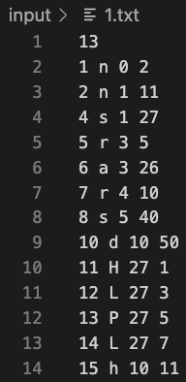
2. Formats: Input
The input file contains events (units & items) that appear depending on the frame.
First line
# of events (<300)
Remaining lines
[The frame at which the unit appears] [unit_symbol] [unit_position_y] [unit_position_x]
Unit Symbol | M | ‘, ^, ! | P | L | n
Class Type | My_plane | Bullet | Powerup_bullet | Levelup_bullet | Enemy_1n
Unit Symbol | r | s | d | a | *
Class Type | Enemy_2r | Enemy_3s | Enemy_4d | Enemy_5a | Enemy_bullet

Slide 12
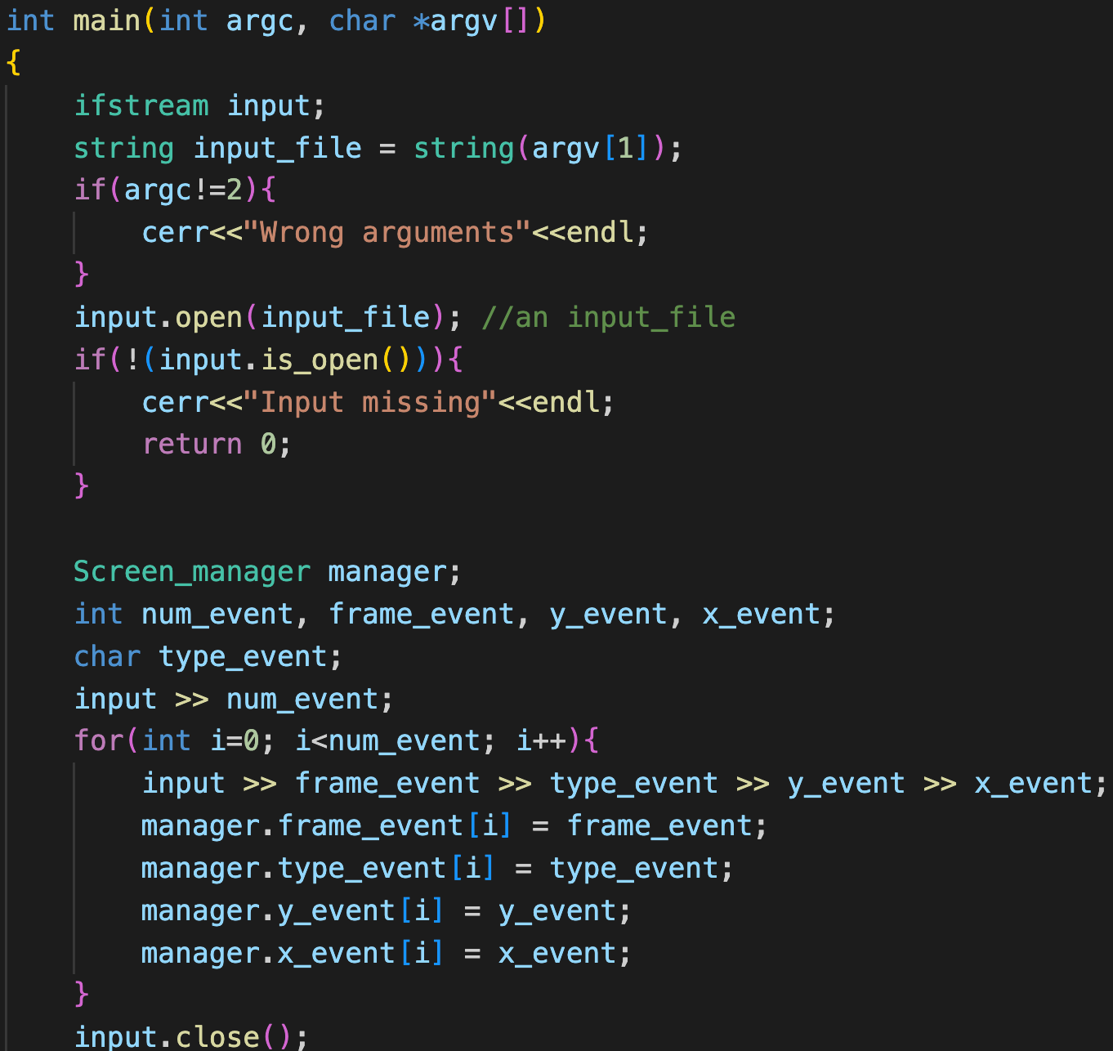
3. Skeleton code: Mac
The code for reading an input file is already implemented.
Don’t modify this code!

Slide 13
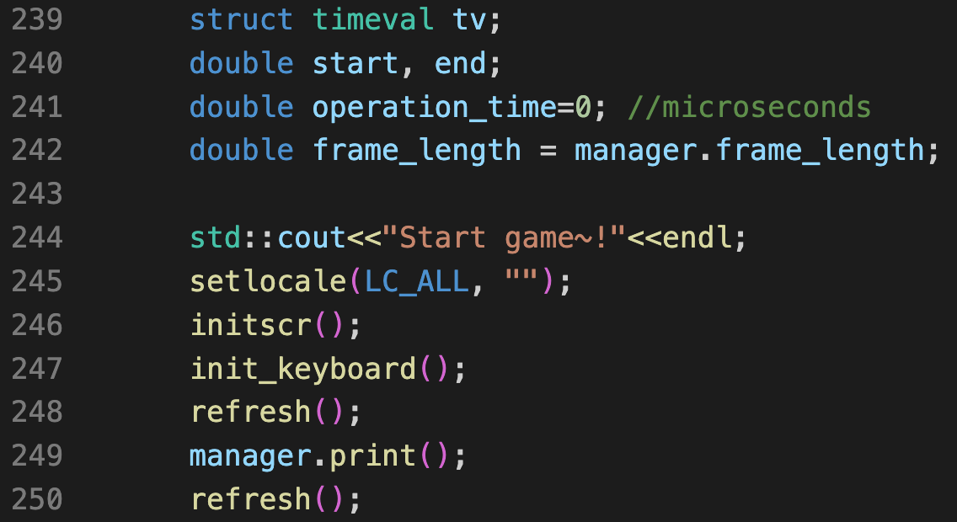
3. Skeleton code: Mac
Execute functions for console control on Mac.
‘tv’ variable for time measurement.
Don’t modify this code!

Slide 14
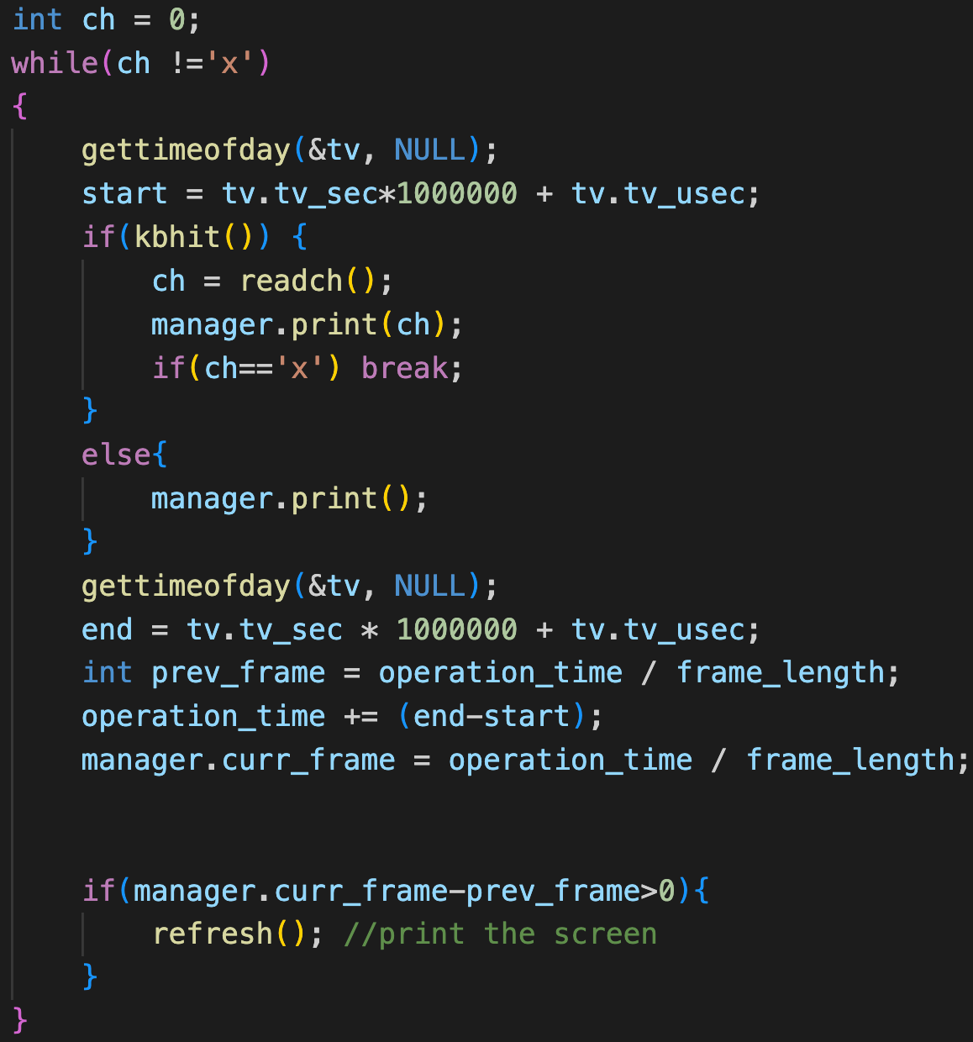
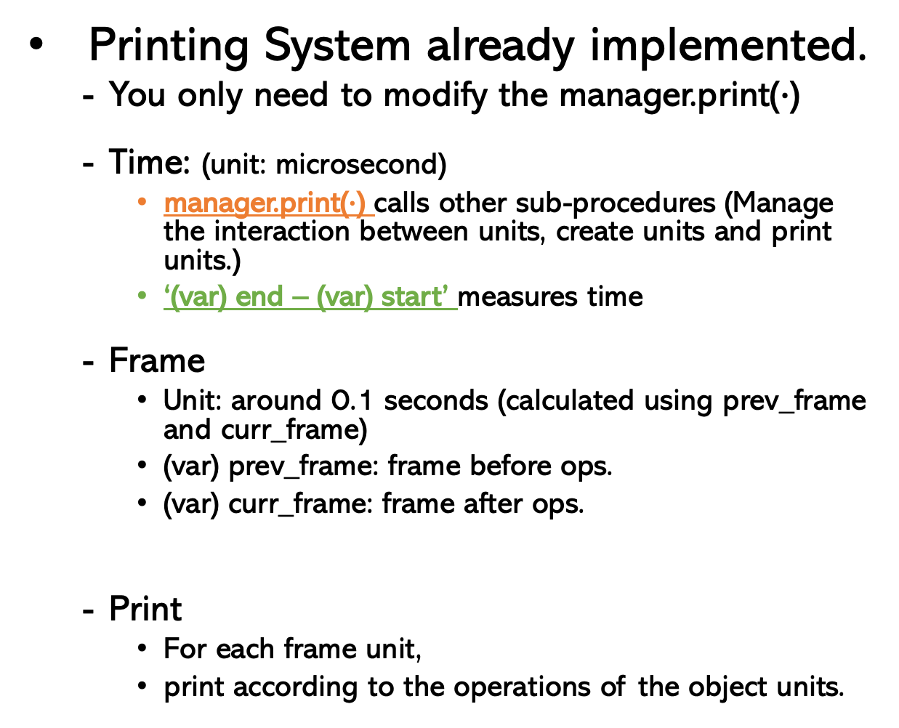
3. Skeleton code: Mac
Printing System already implemented.
You only need to modify the manager.print($∙$)
Time: (unit: microsecond)
manager.print($∙$) calls other sub-procedures (Manage the interaction between units, create units and print units.)
‘(var) end – (var) start’ measures time
Frame
Unit: around 0.1 seconds (calculated using prev_frame and curr_frame)
(var) prev_frame: frame before ops.
(var) curr_frame: frame after ops.
Print
For each frame unit,
print according to the operations of the object units.
Frame: 1 1 2
Operation_time: 180,000(0.18sec) 190,000(0.19sec) 210,000(0.21sec)

Slide 15
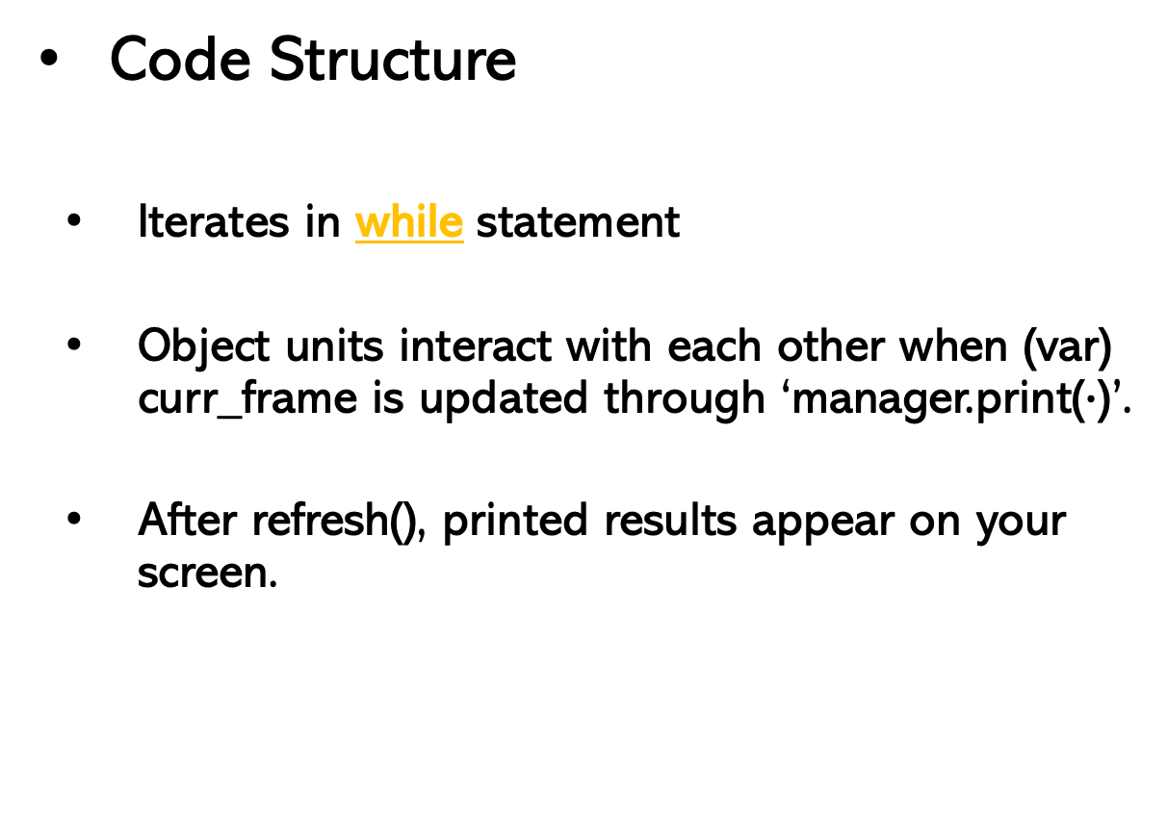
3. Skeleton code: Mac
Code Structure
Iterates in while statement
Object units interact with each other when (var) curr_frame is updated through ‘manager.print($∙$)’.
After refresh(), printed results appear on your screen.

Slide 16
3. Skeleton code: Mac
If any key is pressed
readch( ) : Returns the pressed key
Call manager.print(ch)
If ch==‘x’, break.
If you don’t press any key
Call manager.print( )

Slide 17
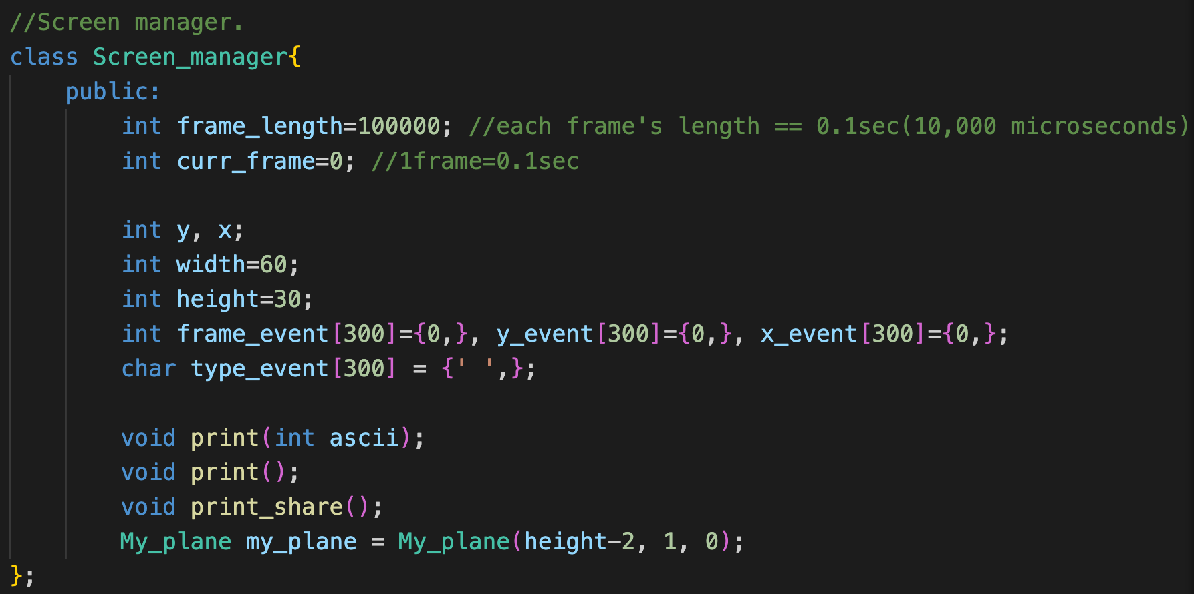
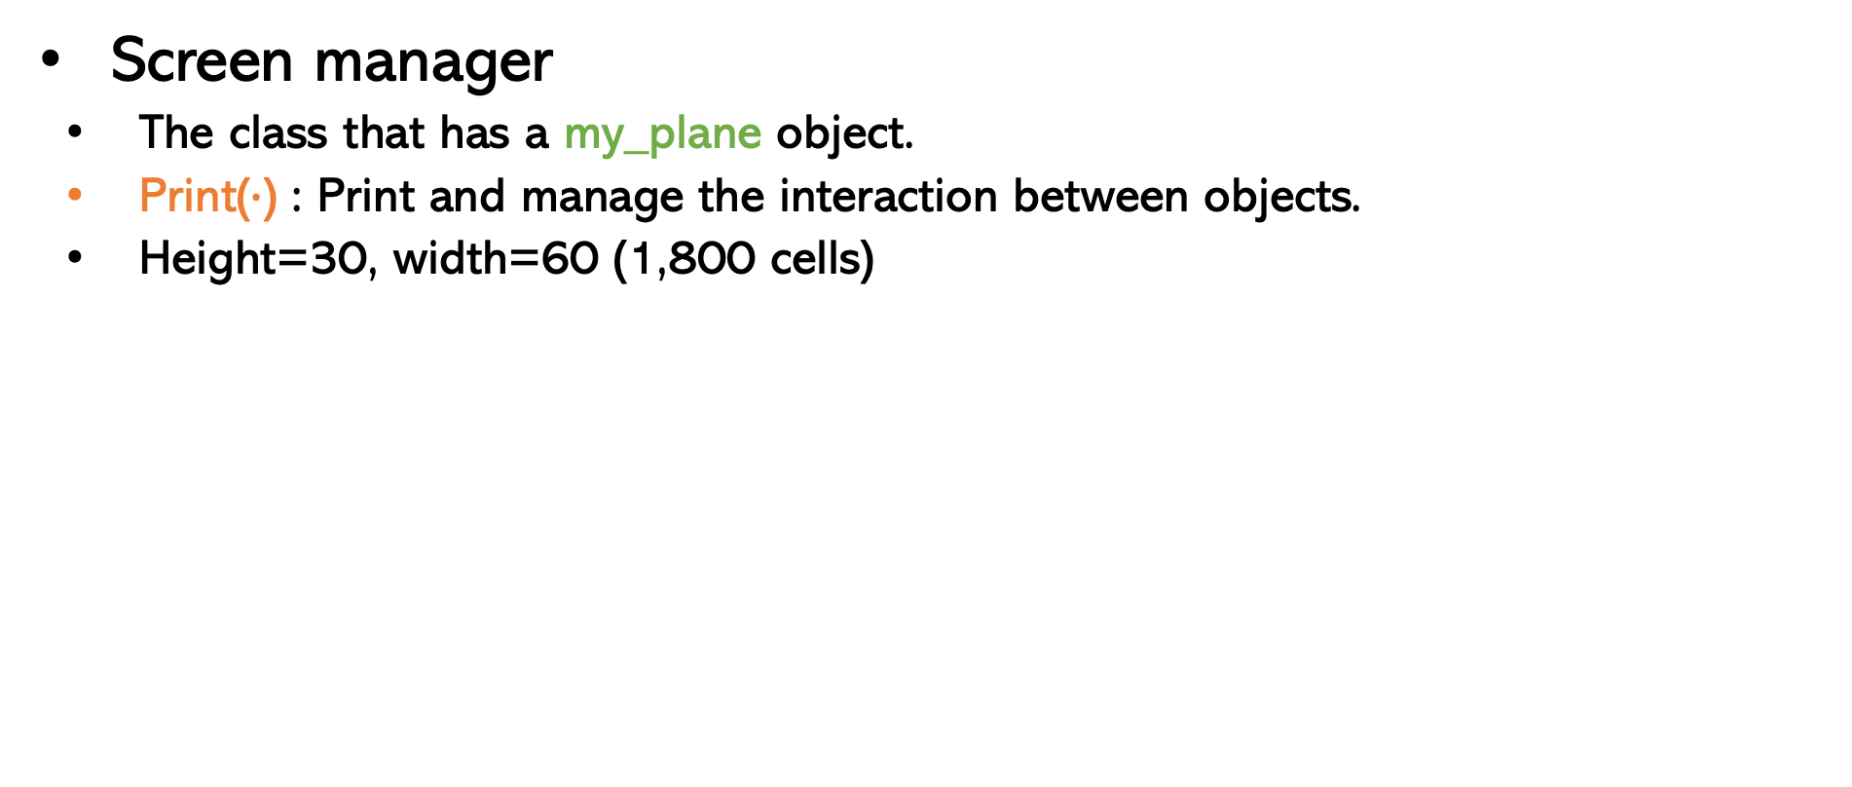
3. Skeleton code: Mac
Screen manager
The class that has a my_plane object.
Print($∙$) : Print and manage the interaction between objects.
Height=30, width=60 (1,800 cells)
(0, 0)
(0, width-1)
screen
(height-1, 0)
(height-1,
width-1)

Slide 18
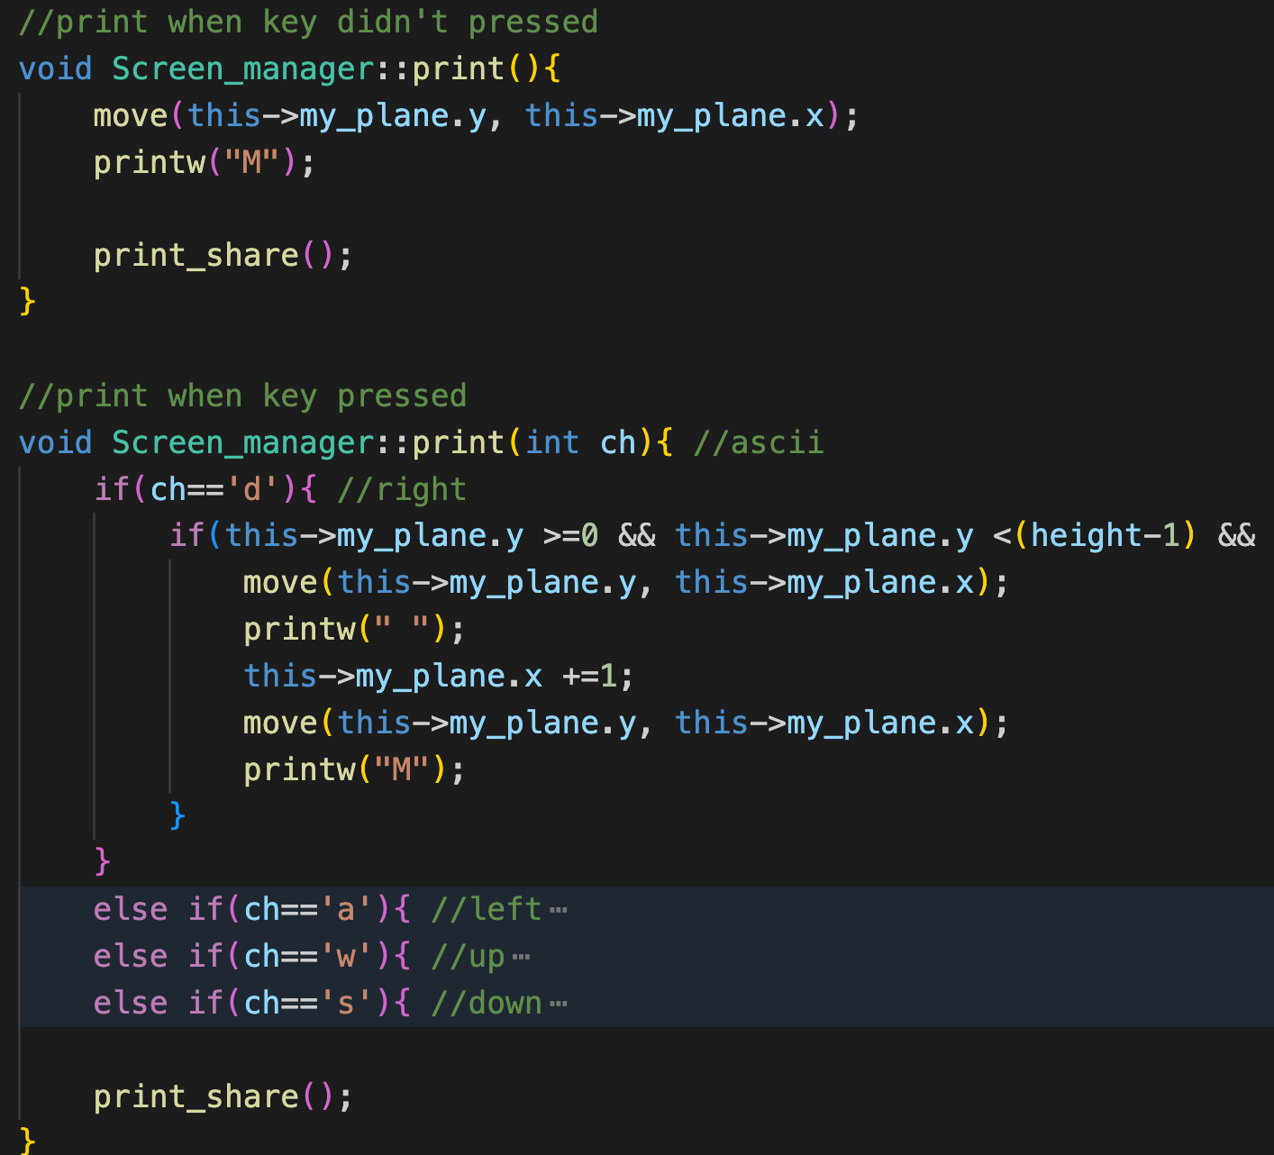
3. Skeleton code: Mac
Print( ) : Print my_plane. Then call print_share( ).
Print(ch) : You can move my_plane using the ‘w, a, s, d’ keys. Then, call print_share( ).
Clear the previous location of my_plane.
Update the location of my_plane.
Print my_plane at the new location.

Slide 19
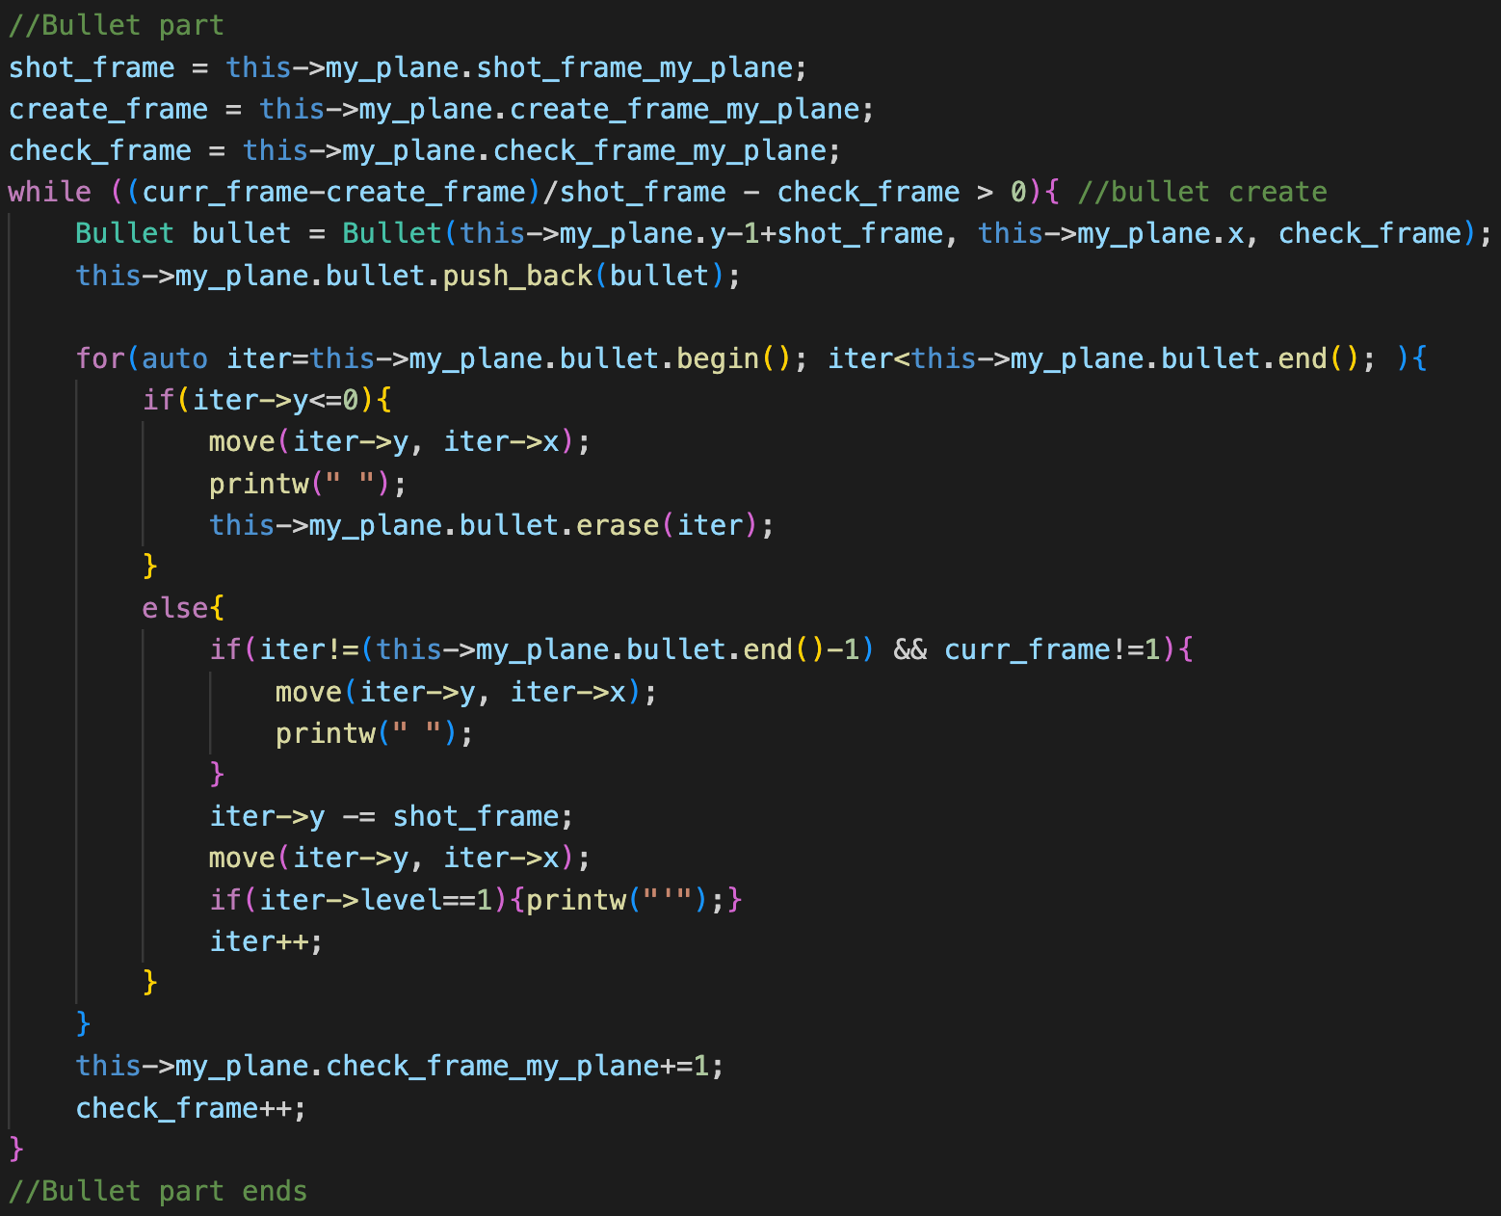
3. Skeleton code: Mac
print_share( )
Interactions between units.
Print units.
Create units.
ex) Create a bullet
Bullets that reach the end of the board disappear.
Move bullets that are already generated.

Slide 20
3. Skeleton code: Mac
All objects have ‘create_frame’.
Objects can move and shoot every n frame.
After curr_frame is updated, each object acts appropriately when the condition is met.
e.g., condition : (curr_frame-create_frame) / cell_speed – check_frame>0
e.g., condition : (curr_frame-create_frame) / shot_frame – check_frame>0
e.g., One unit moves every 3 frames.
frame index: 0 1 2 3 4 5 6 7 8 9 10 11
Previous value of
(curr_frame – create_frame) / shot_frame
The frame at which the unit was created!
A frame at which the unit moves!

Slide 21
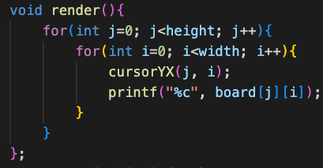
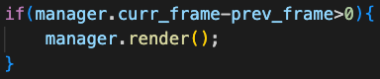
3. Skeleton code: Windows
Similar to Skeleton code (Mac)
Use manager.render( ) for print.
(It may be useful to see both skeleton codes.)

Slide 22
4. Todo: Unit
We will check the class implementation and the interaction between objects. (Don’t change the class name!)
You must implement all units as a class. (See p.3 and p.5)
2. Inheritance and polymorphism should be actively utilized. We will check this part importantly.
e.g. Inheritance tree
n
r
a
s
d

Slide 23
4. Todo: Unit
3. Enemies and enemy_bullets disappear when they reach the end of the wall.
4. All units pass through each other and can exist in the same cell.
You can print anything if there’s more than one object on one cell.
However, my_plane (M) must be printed.

Slide 24
4. Todo: Unit
1.My_plane (M)
hp=5
shot_frame=1
Create a bullet in every frame.
vector<Bullet *> or vector<Bullet>
2.Bullet (‘, ^, !)
cell_speed = 1
‘cell_speed’ means the number of frames taken to move 1 cell.)
If cell_speed=1, it means the bullet moves 1 cell for every 0.1 seconds.
The symbol changes depending on the level.
level=1,2,3 → symbol: ‘, ^, !
The damage from the bullet is equal to the level.
damage=level
When you implement the classes, please write your class name as if it were marked in red!!

Slide 25


4. Todo: Unit
3.Powerup_bullet (P)
The total number of bullets that my_plane generates increases to 3.
4.Levelup_bullet (L)
Increases the level of the bullet.
Bullet.level++

Slide 26

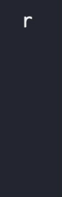
4. Todo: Unit
5.Enemy_1n (n): normal unit
hp=10
It can’t move.
score=1
6.Enemy_2r (r): running unit
hp=5
cell_speed=3
It means the enemy moves 1 cell for every 0.3 seconds.
score=2

Slide 27
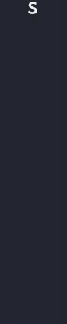
4. Todo: Unit
7.Enemy_3s (s) : shooting unit
hp=4
cell_speed=9
It means the enemy moves 1 cell for every 0.9 seconds.
Creates an Enemy_bullet( ) immediately after moves.
score=3

Slide 28
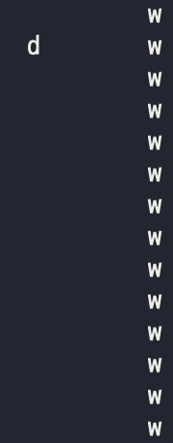
4. Todo: Unit
8.Enemy_4d (d) : diagonal shooting unit
hp=5
cell_speed=3
It means the enemy moves 1 cell for every 0.3 seconds.
Creates an Enemy_bullet( ) immediately after moves.
The bullet moves diagonally to the nearest of both walls.
score=4

Slide 29
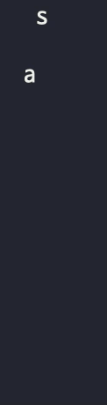
4. Todo: Unit
9.Enemy_5a (a) : power buff unit
hp=8
buff_speed=6
It means the unit gives buffs every 0.6 seconds.
Give permanent buffs to other units within the ‘buff range’ (For 7*7 cells where the unit is centrally located).
Increases damage by 1 for the bullets that the buffed object will generate.
Buffed units are printed in capital letters
It can’t move.
score=5
r
S
*
a
*
*
*
N
buff range

Slide 30
4. Todo: Unit
10.Enemy_bullet (*)
cell_speed=1
It means the bullet moves 1 cell for every 0.1 seconds.
damage=1
Damage of enemy_bullets can be increased by enemy_5a.

Slide 31
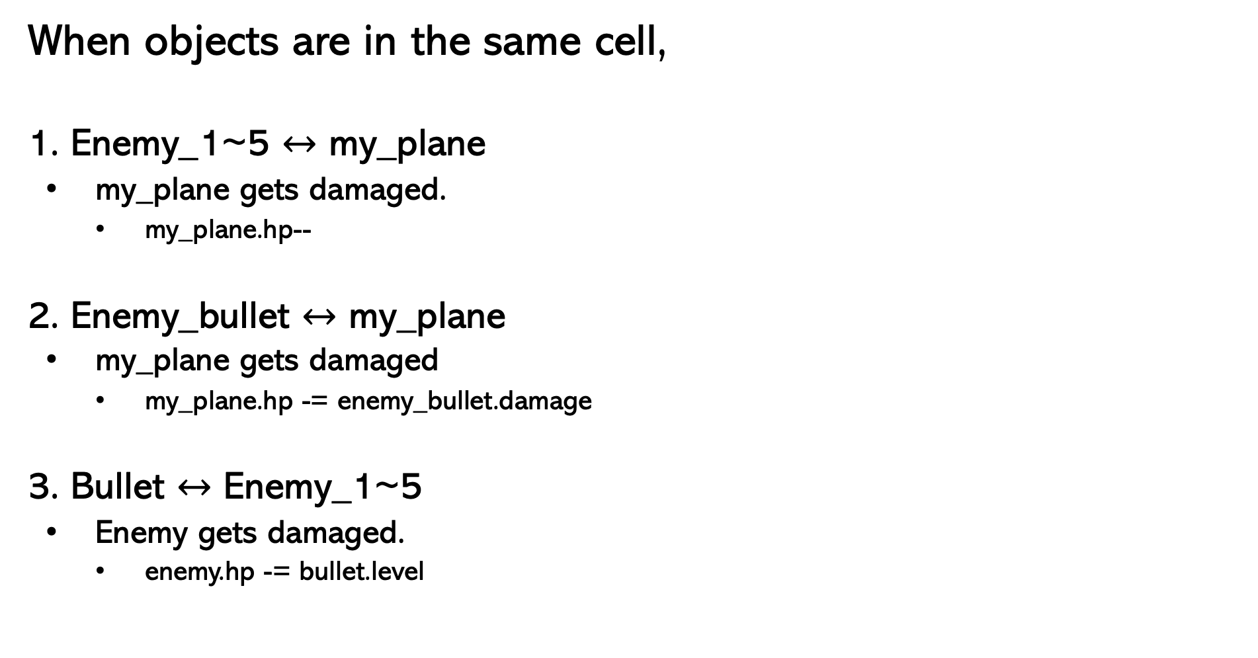
4. Todo: Interaction between class objects
When objects are in the same cell,
1. Enemy_1~5 $↔$ my_plane
my_plane gets damaged.
my_plane.hp--
2. Enemy_bullet $↔$ my_plane
my_plane gets damaged
my_plane.hp -= enemy_bullet.damage
3. Bullet $↔$ Enemy_1~5
Enemy gets damaged.
enemy.hp -= bullet.level

Slide 32
4. Todo: Overall System
Create events from the input file.
If my_plane’s hp is less than or equal to 0, the game ends.
If all enemies are dead, and all the events received from the input file are generated, the game ends.
Press the 'p' key to pause the game. You can press any key to resume.
When the game is over, you must print the total score and the number of kills by enemy unit type.

Slide 33
5. Extra Credits
Extra credits are available for additional feature implementations
The features will be graded by their difficulty and creativity
Ex1) Additional enemy units and items
Units that detonate, Bullets that freeze enemy, etc
Ex2) Multi-threading
If multi-threading is used, there has to be some benefit (speed, frame rate, etc)
Current program does not require much computational power, so you should make something that is computationally heavy for multi-threading to be meaningful
If you have implemented additional features, please submit a report that explains what you implemented
.pdf only
Free form, but must include the following for us to understand your effort
Explanation of the features
How to demonstrate the feature
Implementation strategy

Slide 34
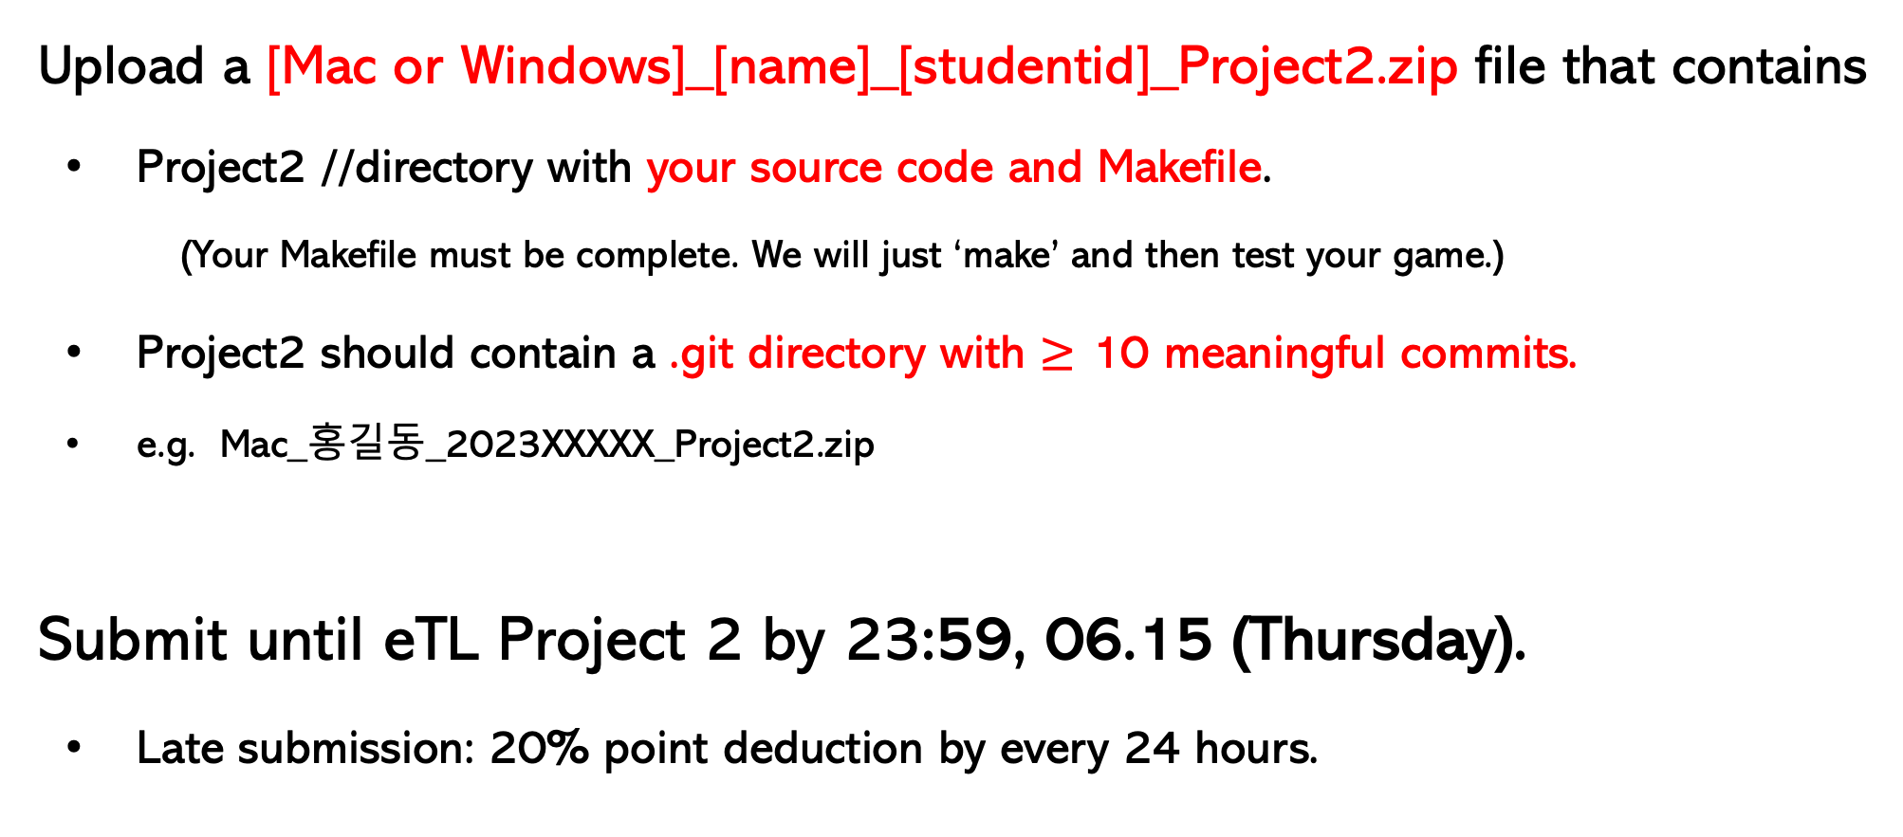
6. Deadline
Upload a [Mac or Windows]_[name]_[studentid]_Project2.zip file that contains
Project2 //directory with your source code and Makefile.
(Your Makefile must be complete. We will just ‘make’ and then test your game.)
Project2 should contain a .git directory with $≥$ 10 meaningful commits.
e.g. Mac_홍길동_2023XXXXX_Project2.zip
Submit until eTL Project 2 by 23:59, 06.15 (Thursday).
Late submission: 20% point deduction by every 24 hours.

